Slide 1
The Mathematics of Web Search
James Liporace

Slide 2
Background
A search engine is a web-based tool that enables users to locate information on the World Wide Web. Popular examples of search engines are Google, Yahoo!, and MSN Search¹
In specific we are going to look at Google and how they use math to create algorithms that help users navigate thru the web

Slide 3
How Do We Find What We Want?
There are 644 million websites world wide with countless number of pages¹
Google alone handles 6 billion searches a day and over 2 trillion search a year ¹
How do we find exactly what we are looking we are looking for in an endless sea of information?

Slide 4
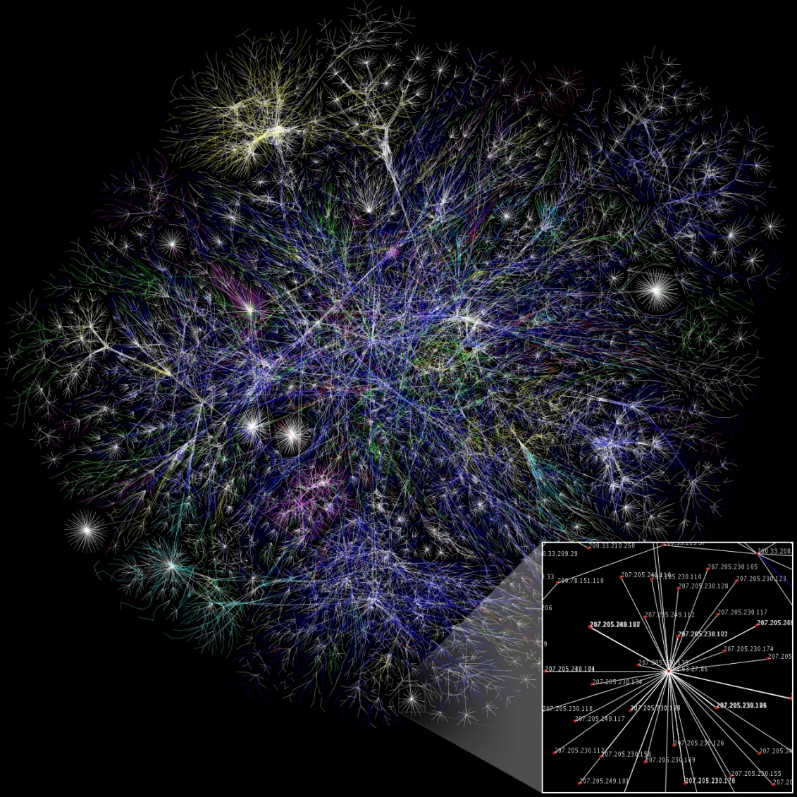

Slide 5
PageRank
PageRank was developed by Larry Page
In short PageRank is a “vote”, by all the other pages on the Web, about how important a page is. A link to a page counts as a vote of support. If there’s no link there’s no support ¹
Google ranks webpages according to the percentage of time one would end up at each web on a random walk through the web.²

Slide 6
What Math does PageRank use?
Linear algebra
Stochastic processes(Markov Chain)
Graph Theory
Probability

Slide 7
Basics of Graph Theory
A graph is an object that consists of a non-empty set of vertices and another set of edges. When working with real-world examples of graphs, we sometimes refer to them as networks. ⁴
Our primary focus is on directed graphs where the edges have a direction associated with them.

Slide 8
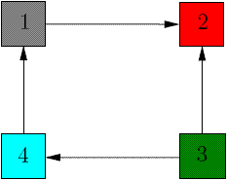
We say that two vertices i and j of a directed graph are joined or adjacent if there is an edge from i to j or from j and i.⁴

Slide 9
Markov Chain
A Markov Chain is a random process in which the future is independent of the past, given the present.

Slide 10
Random Walks in Graphs
The Random Surfer Model¹
The simplified model: the standing probability distribution of a random walk on the graph of the web. Simply keeps clicking successive links at random
The Modified Model¹
The modified model: the “random surfer” simply keeps clicking successive links at random, but periodically “gets bored” and jumps to a random page based on the distribution of E

Slide 11
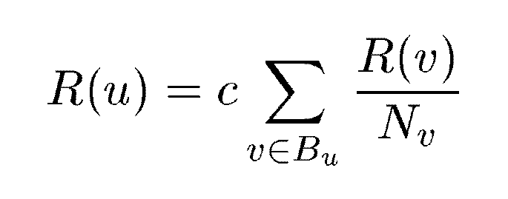
A Simple Version of PageRank
u: a web page
B_{u}: the set of u’s backlinks
N_{v}: the number of forward links of page v
c: the normalization factor to make ||R||_{L1} = 1 (||R||_{L1}= |R₁ + … + R_{n}|)

Slide 12
How to Find the Weight of Direction ³
Each page will transfer evenly its importance to the pages that it links to. If a node has k outgoing edges, it will pass on 1/k of its importance to each of the nodes that it links to.

Slide 13
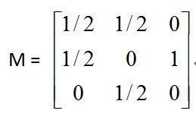
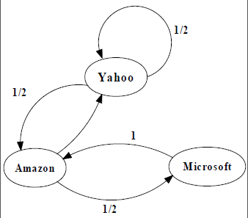
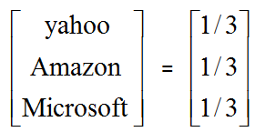
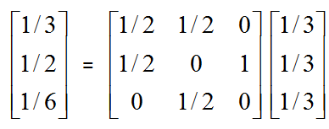
An example of Simplified PageRank
PageRank Calculation: first iteration

Slide 14
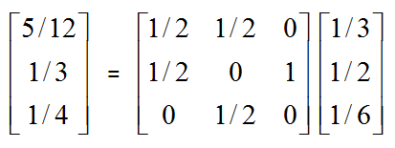
An example of Simplified PageRank
PageRank Calculation: second iteration

Slide 15
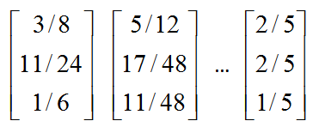
An example of Simplified PageRank
Convergence after some iterations

Slide 16
Modified Version of PageRank
E(u): a distribution of ranks of web pages that “users” jump to
when they “gets bored” after successive links at random.

Slide 17
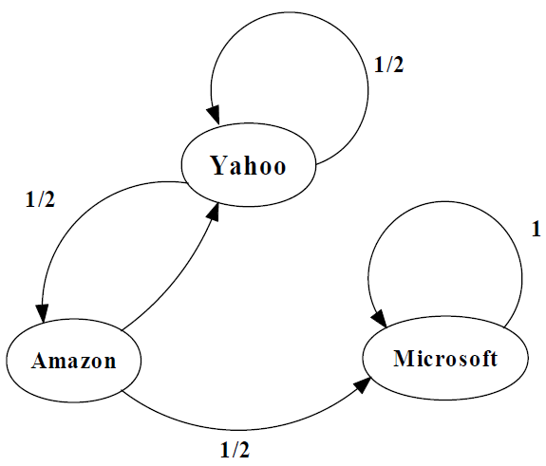
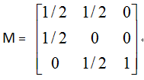
An example of Modified PageRank

Slide 18
References
1. Brin, S., & Page, L. (n.d.). The Anatomy of a Large-Scale Hypertextual Web Search Engine. Retrieved from http://infolab.stanford.edu/: http://infolab.stanford.edu/~backrub/google.html
2. Tanase, R., & Remus , R. (2009). The Mathematics of Web Search. Retrieved from cornell.edu: http://www.math.cornell.edu/~mec/Winter2009/RalucaRemus/
3. Wills, R. S. (2006). Google’s PageRank:The Math Behind the Search Engine.
Image-Tanase, R., & Remus , R. (2009). The Mathematics of Web Search. Retrieved from cornell.edu:
4. www.wolframalpha.com

